Slide 1
Introduction and Welcome
What the course aims to do (next slide)
Link to supporting PDF
Reference the TDT guide and the specific SSMs on TOL

Slide 2
Intro text
The purpose of this eLearning course is to give a more detailed insight into both key and keyless immobiliser systems that Triumph motorcycles use . For a more general appreciation of the Triumph Diagnostic Tool and user instructions relating to these systems, technicians are recommended to refer to the diagnostic tool user guide that can be found on Triumph Online (TOL) Service and Technical section .

Slide 3
Navigation
Links to each section – becoming available to open in sequence so jumping back is possible, but not skipping forward.

Slide 4
Key vs Keyless Immobiliser Comparrison
In this section we will compare the two types of security system in general terms.
While this will concern the two basic types it should be remembered that there are in fact four different approaches that have been, or are currently, used on Triumph motorcycles
In each case the technician should remember that the customer experience of these systems is one of turning on and starting the motorcycle, but there is a complex security system behind the user interface.

Slide 5
Similarities of Key and Keyless Immobiliser
They are both means to isolate enge run/start in the event of a theft attempt
Both include a mechanical steering lock function
Both contain the TPMS systems (where fitted as an option)

Slide 6
There are 4 types of immobiliser system used across the model range
Comment…?
Immobiliser Function Location | Key/Keyless | Example Models
RCU (Receiver Control Unit) | Key | Keyed immobiliser models (not 400cc)
CCU (Chassis Control Unit) | Keyless | Early Tiger Models only
KCU (Keyless Control Unit) | Keyless | All other keyless models
Immobiliser | Key | 400cc models

Slide 7
Principal Differences of Key and Keyless Immobiliser / Ignition System
KEY System –
In a traditional key-operated motorcycle ignition system, the rider inserts a physical key into the ignition slot.
The antenna ring, integrated around the key barrel, reads the RFID (Radio Frequency Identification) signal embedded in the key.
Once the key is turned, the antenna relays this data to the receiver control unit (RCU), which interfaces with the immobilizer system.
Upon verifying the correct key, the immobilizer disengages, allowing the ECU (electronic control unit) to activate the electronic fuel injection system (efi).
With fuel delivery enabled, the engine control system enables efi, and the motorcycle is allowed to start.
KEYLESS System –
In contrast, a keyless motorcycle ignition system relies on proximity technology.
The rider carries a smart fob, which emits a secure radio frequency signal. When the rider approaches within a 1m radius, the onboard receiver unit detects the fob’s signal.
As the rider presses the start button, the system autonomously authenticates the fob with a secure set of handshake sequences.
Once validated, the RCU or CCU (chassis control unit) or KCU (keyless control unit), this will depend on system and model, authorizes the efi ECU to enable ignition and fuel delivery.
Thus, the motorcycle starts without physical key insertion, relying instead on encrypted proximity communication.

Slide 8
Feature | Key Ignition System | Keyless Ignition System
Authentication Method | Physical RFID key detection | Proximity-based encrypted fob communication
Security | Moderate (key can be lost or copied) | High (encryption and proximity add security)
Complexity of Use | Simple, traditional operation | Slightly more complex, automatic detection
Reliability | Proven, long-term technology | Dependent on battery in fob
Convenience | Requires manual key insertion | Seamless, no physical action needed
Vulnerability to Theft | Key duplication possible | Potential fob hacking, relay attacks unless key is ‘off’
Cost | Lower, simple mechanical components | Higher, advanced electronic modules
Maintenance | Low, minimal wear parts | Medium, fob battery replacement required
Notes:
Reveal pairs of options in sequence – learners drop the description into the box they think is correct and hit the validate button. On correct choice the next options appear for the next row – on incorrect they should highlight in some way with an opportunity to try again (I say try, there’s only one other combination possible!) and re-validate.

Slide 9
Summary of the Immobiliser Systems
Notes:
Random reveals maybe but some of this is crucial grounding – exercise on following slide

Slide 10
Some Principal Differences
For which immobiliser systems are these components / facts true? Drag to the correct box:
Key Systems
Keyless Systems
RCU (Receiver Control Unit)
CCU (Chassis Control Unit)
KCU (Keyless Control Unit)
Max memorised keys: 4
Max memorised keys: 3
Submit
Notes:
Allow several attempts
Feedback needs to state “The immobiliser function was only contained within the CCU for early Tiger 1200 models”

Slide 11
Differences in Components of the Systems
Which components belong to which immobiliser system? Drag to the correct box:
Keyed Immobiliser System
All Immobiliser Systems
Keyless Immobiliser System
RCU
Passive Key
Active Key
Mechanical Steering lock
TPMS function
KCU (or CCU)
Antenna Ring
Electronic Steering lock
Fuel Filler Cap
LF Antenna

Slide 12
Key Type Immobiliser Systems
Those models that rely on a physical key to turn the motorcycle on also use a transponder recognition system to ensure that a theft that relies on the overcoming the mechanical security of the key barrel will still be thwarted by a second, electronic layer of security that means critical functions (engine management and starting) will not respond.

Slide 13
Some Details
Transponder in key 125Khz
Comms / paired with RCU (receiver control unit) / Immobiliser
Keys must be separated with RCU via antenna ring
Max 4 keys per bike (depending on model)
TPMS also is paired to the RCU (if fitted)
TDT required to pair keys / immobiliser / TPMS
Cut keys available to order from Triumph for certain models only (see epc for details) As a rule, generally smart ‘keyless’ keys do not have blank key blade support, whereas immobilisers and seat locks do.
If all keys lost, replacement immobiliser, keys and lockset will be required

Slide 14
Keyless intro
Many models are now available with a keyless ignition system, where the motorcycle can be turned on without having to insert the key in a traditional ignitions switch.
The rider carries the actual key with them in proximity to the motorcycle, which has two low frequency antennae that can detect the UHF radio frequency emitted by the key.
Tpically this function is controlled by a dedicated control module that is connected to the CAN bus: The KCU (keyless control unit)*
* Some early Tiger 1200 models incorporated the function into the CCU (chassis control unit)

Slide 15
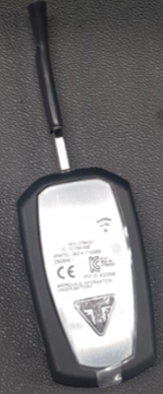

Key to Control Unit Communication
The key recognition process is initiated by the KCU energising the external LF antenna). There are two methods of communication from the key to the KCU, either via UHF (for “smart” keys) or LF (as a backup method for “smart” keys and used for “non-smart” keys).
The key recognition process is initiated by the KCU energising the external LF antenna(e). There are two methods of communication from the key to the KCU, either via UHF (for “smart” keys) or LF (as a backup method for “smart” keys and used for “non-smart” keys).
The key recognition is based on a mutual identification and authentication between the transponder and the RCU KCU or CCU.
Notes:
Bits of info

Slide 16
Key to Control Unit Communication
The key recognition process is initiated by the KCU energising the external LF antenna(e). There are two methods of communication from the key to the KCU, either via UHF (for “smart” keys) or LF (as a backup method for “smart” keys and used for “non-smart” keys).
“non-smart” keys. “smart” keys
The key recognition process must remain transparent for the rider, and therefore the time taken to authenticate the key should be as short as practicable. The overall time before the key authentication result is available should be a maximum of approximately 5 seconds. The nominal time before the key authentication result is available however is 200ms.
The first key identification process should be of “smart” keys (via UHF, then LF), followed by any paired “non-smart” keys (via LF only). In addition, if multiple LF antennas are present, the key identification process should poll for each key via each antenna, before attempting to identify a different key.
Point of interest - In a motorcycle keyless ignition system, UHF (ultra-high frequency) and LF (low frequency) are two distinct communication bands. LF, typically around 125 kHz, is used for the initial authentication, as it offers better range for close-proximity detection and is less prone to interference. UHF, either 315 or 434 MHz range, is used for active communication once the system is engaged, allowing for longer range and more secure data transfer. In short, LF handles proximity sensing, while UHF supports the ongoing communication once the key is near.

Slide 17
Key to Control Unit Communication
Point of interest - In a motorcycle keyless ignition system, UHF (ultra-high frequency) and LF (low frequency) are two distinct communication bands. LF, typically around 125 kHz, is used for the initial authentication, as it offers better range for close-proximity detection and is less prone to interference.
UHF, either 315 or 434 MHz range, is used for active communication once the system is engaged, allowing for longer range and more secure data transfer.
In short, LF handles proximity sensing, while UHF supports the ongoing communication once the key is near.

Slide 18
Question: What allows a rider to start a motorcycle fitted with a keyless ignition system?
Options:
The key transmits its identity wirelessly . ✅
The ignition switch reads a magnetic strip inside the key.
The motorcycle stores the rider's fingerprint.
The key must physically fit into the barrel of the ignition switch and the teeth be in the correct format.
Feedback: Correct. The key communicates wirelessly with the motorcycle when it is within range.

Slide 19
Question: Which of the following are involved in recognising a valid key?
(Select all that apply.)
✅ LF antenna(s)
✅ The key (transponder)
✅ Keyless Control Unit (KCU)
Engine oil pressure switch
Clutch switch
Feedback: The LF antenna initiates communication, the key responds, and the KCU authenticates the key before allowing operation.

Slide 20
Question:
What is the purpose of the communication between the key and the KCU?
Options:
To check the key’s of the correct type.
To exchange a mutual authentication before enabling the system. ✅
To upload service history to the motorcycle.
To synchronise the instruments.
Feedback:
Correct. The motorcycle only enables operation after successfully authenticating the key.

Slide 21
Example – keyless system ignition-on process YELLOW - What customer perceives as being the state of bike. BLUE – Actual state of bike.
BIKE IS “OFF”
User presses either “power” or “start” button
Keyless control unit (KCU) wakes up
KCU checks for recognised key being available and for matching ESL identification.
If the KCU finds a recognised key and confirms the ESL identification, it will apply power to the “12v ignition” input to all other components
All other components wake up simultaneously, except ECU which will only wake up if the kill switch is in the “run” position
When ECU wakes, it queries key authentication state from KCU (KCU responds key is authenticated)
ECU and KCU then exchange security keys as final step of immobiliser functionality
If ECU-KCU exchange is OK, engine can be started.
BIKE IS “ON”
BIKE CAN START
Notes:
YELLOW - What customer perceives as being the state of bike.

Slide 22
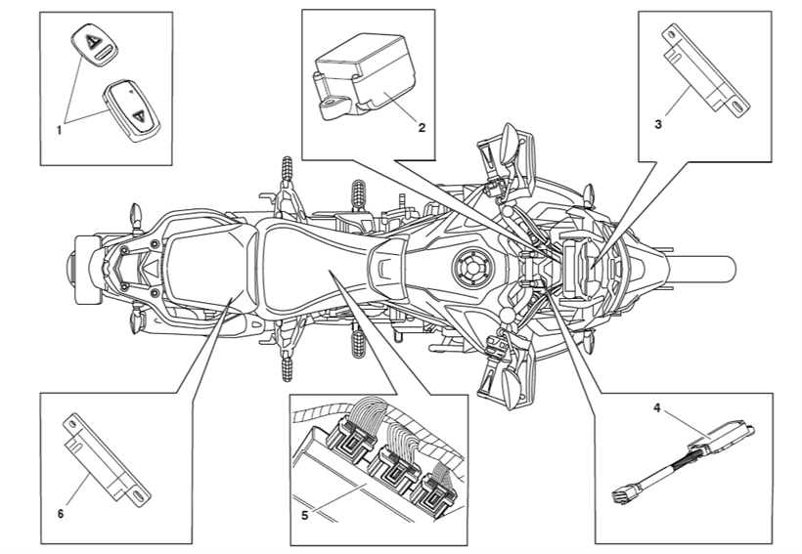
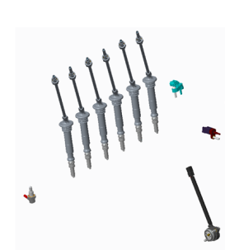
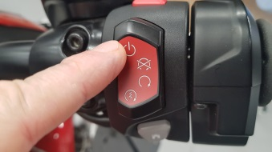
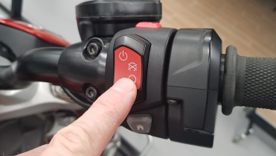

Wake Up Sequence – note don’t mix item number up with stage number (Use with previous slide)
3
4
3
2
1. Transponder chip
2. Electronic steering lock
3. LF Antenna (front)
4. Keyless ECM
5. Engine ECM
6. LF Antenna (rear)
Ign System
1
Power Button
5
8
2
6
Check
2
Run Position
7
6. Ignition Circuit (12v controlled via KCU)
Notes:
Use the previous slide to identify the 8 wake up sequence stages.
Item 4 Includes instrument wake up.
When KCU wakes the immobiliser light will flash and you will have access to immobiliser diagnostics.
‘Play’ this slide in ppt view for best understanding.

Slide 23
Important Note
If passive key is used to power the bike up, then a 90 second time limit is applied to the ignition supply. Therefore, if a download is started in this scenario it may fail.
Same applies if smart key goes out of range.
Example: if a rider switches his ignition on using his passive key in close proximity to LF antenna and then removes the key away from the LF antenna , 90 seconds later the ignition will turn itself off. Similarly, if a rider switches the ignition on using his smart key and then walks away with the smart key, outside of the one metre proximity range, for more than 90 seconds , then again, the calibration strategy will switch the ignition off.
Technicians should be aware of this , especially during downloads , as if the ignition switches itself off during the download stage it will automatically fail the download

Slide 24
Key Pairing
Both types of key have transponders that have a unique code which the immobiliser system must recognise as being an authorised key. This is called key pairing.
Key supplied with the motorcycle from new will obviously already be paired, but it may be necessary yo pair other keys to the immobiliser system (either in the immobiliser, the RCU, the KCY or the CCU, depending on the model and the system it uses.
This is done using the TDT (Triumph Diagnostic Tool).

Slide 25
Key Pairing Note
The Add New Key function allows the user to pair one key to the immobiliser system at a time, provided the maximum number of paired keys has not been reached. An attack delay of 5 minutes must pass for each key pairing for security.
The Re-Register All Keys function erases all keys from immobiliser system memory, except the key used to turn the motorcycle ignition ON at the start of the process. The function then allows multiple keys to be paired, up until the maximum number of allowed keys has been reached. An attack delay of 5 minutes must pass for each key pairing. On some motorcycles, an attack delay of 5 minutes must also pass before existing key pairings can be erased.

Slide 26
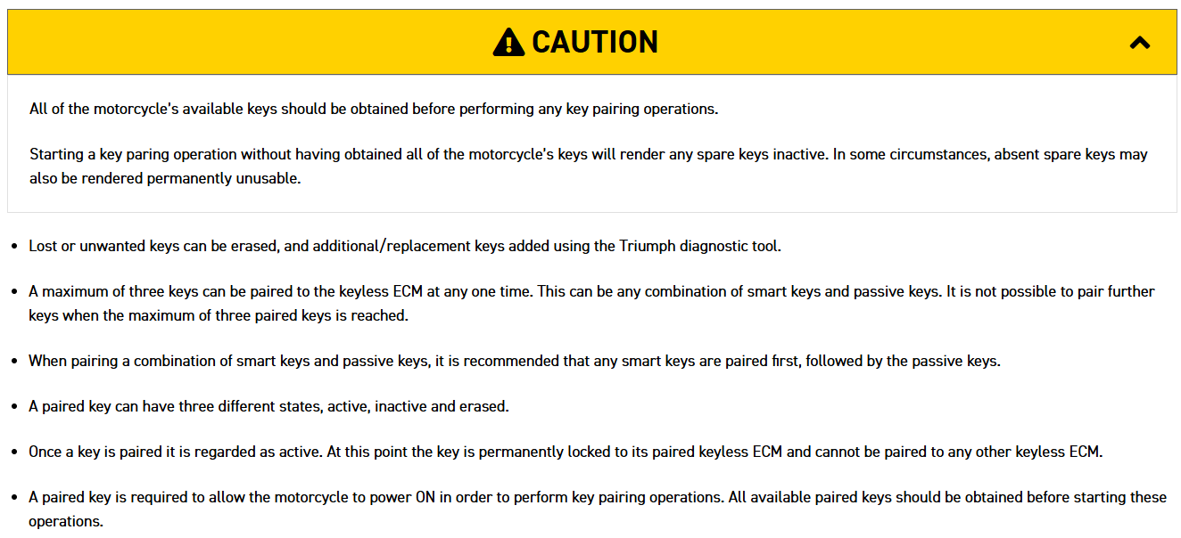
General Key and Keyless Information Points commonly overlooked
All of the motorcycle’s available keys should be obtained before performing any key pairing operations. Starting a key paring operation without having obtained all of the motorcycle’s keys will render any spare keys inactive. In some circumstances, absent spare keys may also be rendered permanently unusable.
Lost or unwanted keys can be erased, and additional/replacement keys added using the Triumph Diagnostic Tool.
A maximum of three keys can be paired to the KCU/CCU at any one time. This can be any combination of smart keys and passive keys. It is not possible to pair further keys when the maximum of three paired keys is reached.
When pairing a combination of smart keys and passive keys, it is recommended that any smart keys are paired first, followed by the passive keys.
A paired key can have three different states, active, inactive and erased.
Once a key is paired it is regarded as active. At this point the key is permanently locked to its paired keyless ECM and cannot be paired to any other keyless ECM – ever!
A paired key is required to allow the motorcycle to power ON in order to perform key pairing operations. All available paired keys should be obtained before starting these operations.
Paired keys can be erased using the Re-Register All Keys function on the Triumph diagnostic tool. When this function is used, the key being used to power the motorcycle will remain paired and active. Any other paired keys will be registered as inactive.

Slide 27
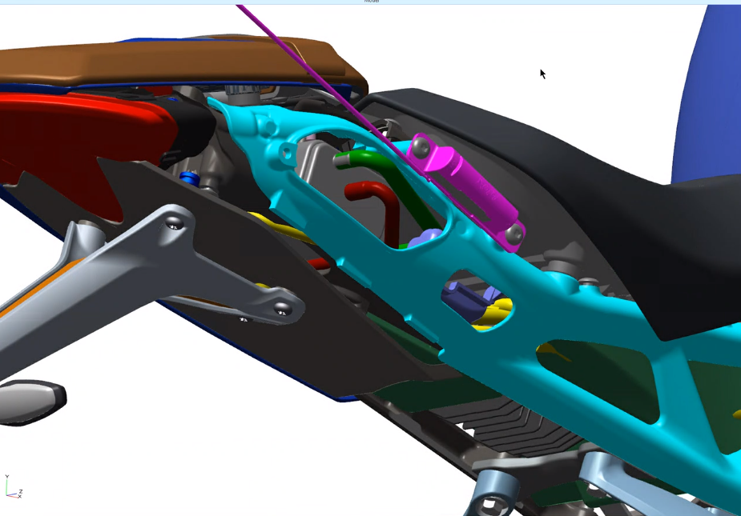
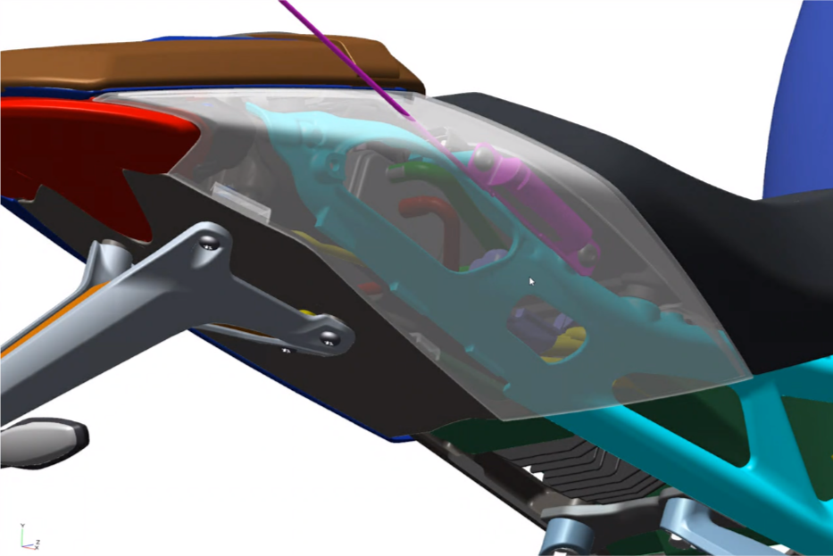
General Information Points (continued)
When using the Re-Register All Keys function, a ten minute (600 second) security time delay is applied to the first key pairing. Further key pairings are subject to a five minute (300 second) time delay.
Inactive keys can be either paired and reactivated, or replaced by new keys and overwritten.
Any inactive keys that are overwritten are then stored as erased in the keyless ECM memory. A maximum of three erased keys can be stored.
Erasing more keys after the maximum of three erased keys has been reached, will result in the erased keys being overwritten. Erased keys that are overwritten are then rendered permanently unusable.
Stored erased keys can be paired and reactivated providing that the maximum number of three paired keys has not been reached. When a key is reactivated, it is moved from its ‘erased’ memory slot to a vacant ‘active’ memory slot.
Note: Keys pair to RCU, CCU or KCU (aka Immobiliser) depending on model
This is covered in a later section
Note: Only rear LF antenna can be used to pair keys

Slide 28
General Key and Keyless Information Points commonly overlooked - 5 Questions
What tool is used to erase or add keys to the keyless ECM?
A. Triumph diagnostic tool ✅
B. Dealer mode on the instrument panel
C. The keyless ECM automatically learns new keys
D. The immobiliser antenna programming tool

Slide 29
General Key and Keyless Information Points commonly overlooked - 5 Questions
2. What is the maximum number of keys that can be paired to the keyless ECM?
A. One
B. Two
C. Three ✅
D. Unlimited, until the ECM memory is full

Slide 30
General Key and Keyless Information Points commonly overlooked - 5 Questions
3. Why is it recommended to pair smart keys before passive keys?
A. Smart keys must be paired first to maintain the correct pairing order. ✅
B. Passive keys prevent smart keys from being recognised later.
C. Smart keys require a fully charged motorcycle battery before pairing.
D. Passive keys can only be paired after the motorcycle has been started.

Slide 31
General Key and Keyless Information Points commonly overlooked - 5 Questions
A technician attempts to pair a key that has previously been paired to another keyless ECM. What should they expect?
The key will pair normally after deleting it from the old motorcycle.
The key can be paired if the battery is removed first.
The key cannot be paired because it is permanently locked to its original ECM. ✅
The key will pair after cycling the ignition three times.

Slide 32
General Key and Keyless Information Points commonly overlooked - 5 Questions
5. After selecting "Re-Register All Keys", how long is the security delay before the first key can be paired?
A. 60 seconds
B. 5 minutes
C. 10 minutes (600 seconds) ✅
D. 30 minutes

Slide 33
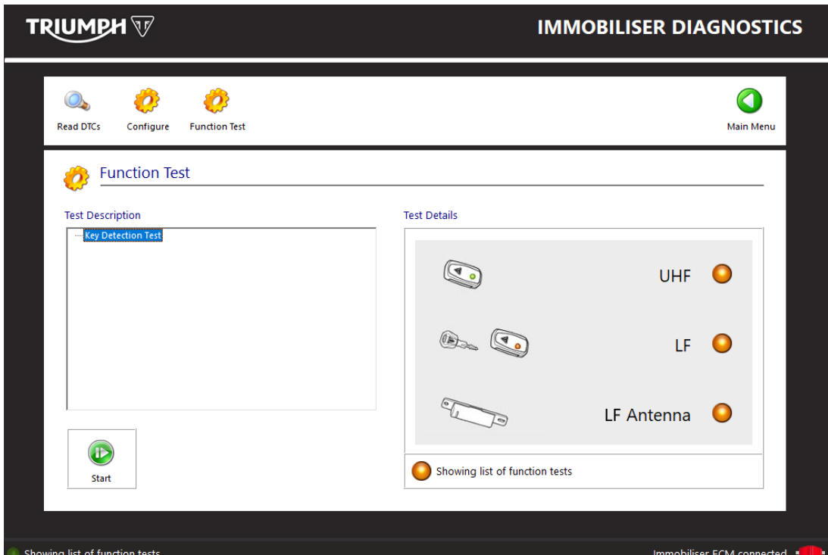
Key Signal Function Test - Keyless Ignition Models
The key signal function test can be used on models with keyless ignition
The function test can be started by clicking the Start button.
When started, the function test will periodically check for detected keys. The test provides three coloured lights for the following:
• UHF (Ultra High Frequency key detection)
• LF (Low Frequency key detection)
• LF Antenna (LF Antenna Status).
The status reported by the coloured lights is refreshed every 2 to 3 seconds while the function test is running.
The coloured light and text displayed in the status bar at the bottom of the Test Details screen will alternate between displaying the test status and test results as follows:
• Amber = Test running
• Red = No keys detected
• Green = Key detected (by either UHF or LF).
The test can be stopped at any time by clicking the Stop button

Slide 34
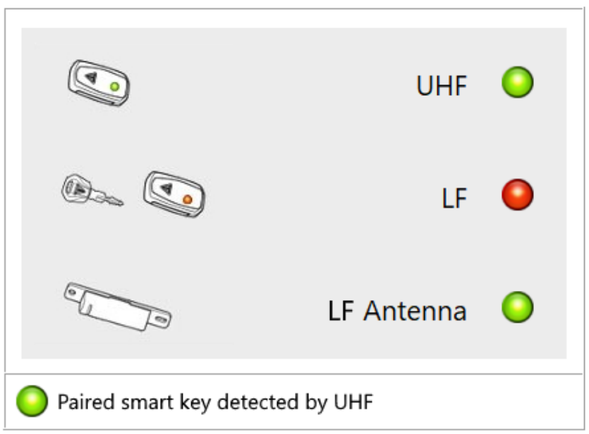
UHF Key Detection
The UHF coloured light provides indication of whether or not a paired, active smart key is being detected by the motorcycle's keyless ignition system. The smart key must be paired to the keyless ECM, and must be in Active mode to be detected by UHF.
Paired smart keys can typically be detected at a range of up to one metre from the motorcycle when in active mode.
Note: The LF antennae detect UHF keys as well as the LF keys.
When the function test is running:
• A red light indicates that no key was detected by UHF method at the last attempt.
• A green light indicates that a paired, active smart key was detected by UHF method at the last attempt

Slide 35
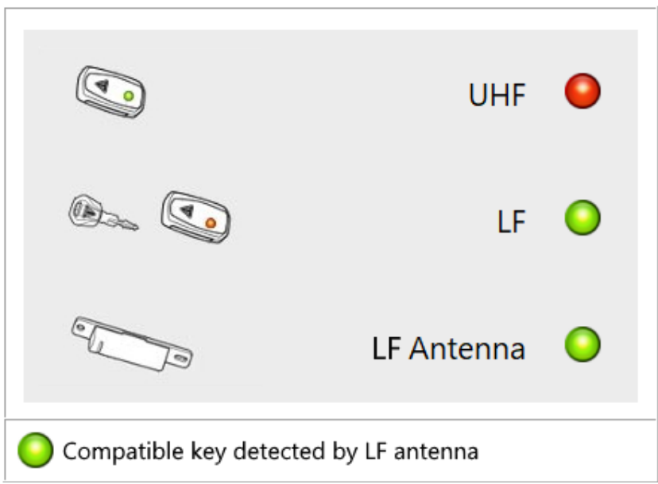
LF Key Detection
The LF coloured light provides indication of whether a compatible key is being detected by the LF antenna.
The LF antenna will detect any key that is compatible with keyless ignition, regardless of whether or not the key has been paired with the keyless ECM.
Compatible keys must be placed in close proximity of the LF antenna (typically within 25 mm) to be detected.
When the function test is running:
• A red light indicates that no key was detected by the LF antenna at the last attempt.
• A green light indicates that a compatible key was detected by the LF antenna at the last attempt
LF Antenna Status
The LF Antenna light provides indication of the status of the LF antenna.
When the function test is running:
• A red light indicates that a LF antenna fault is present.
• A green light indicates that the LF antenna is functioning normally.

Slide 36
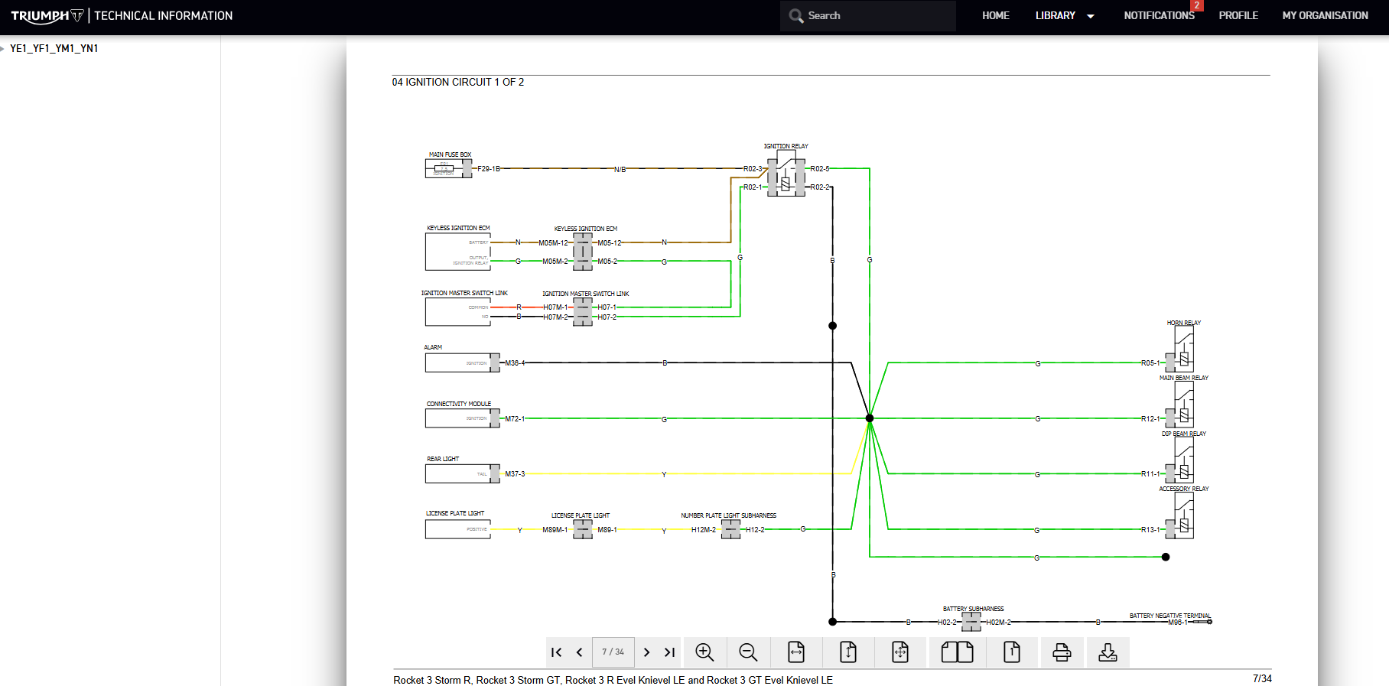
Cooker Knob Isolator Switch - Ignition Master Switch Link
Useful Tip:
US models have an isolator switch.
Models outside of US have a loop-out plug.

Slide 37
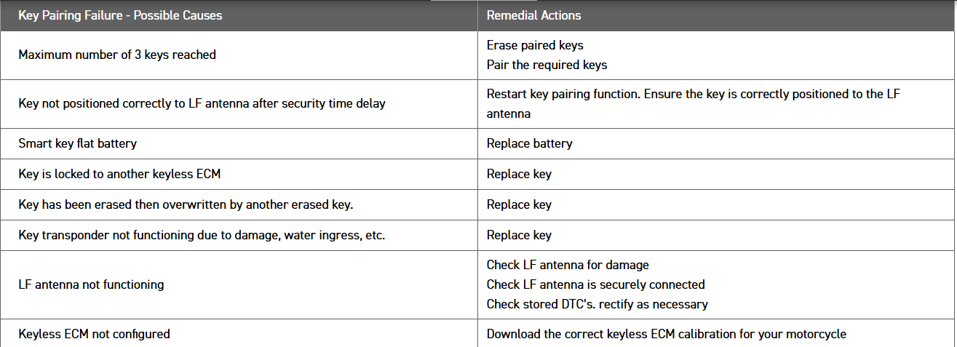
Key pairing failure possible causes
Key pairing can take time to see new key / metal side away from LFA.
Maybe dismount antenna. Persevere!
Front antenna only there for keyless range around bike
Note battery tenders may affect key pairing due to electrical noise etc…

Slide 38
Important Keyless Notes
Bike will allow TDT connection to immobiliser diagnostics for 30 seconds without a key present. It allows connection window of 30 secs but once connected it will stay connected.
So KCU will wake with no key but only gives access to TDT Immobiliser diagnostics
NB Immobiliser light sequence flashes (see table)

Slide 39
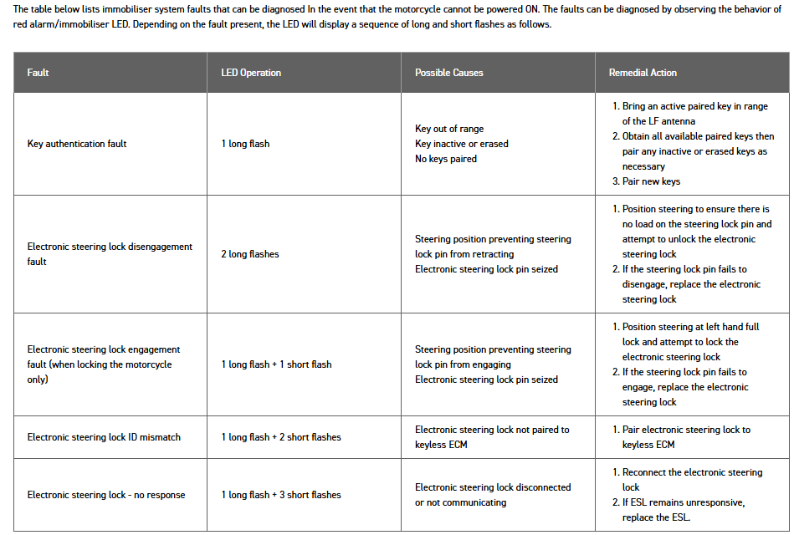
Instrument Panel Flash Sequences

Slide 40
TPMS
The Tyre Pressure Monitoring System (TPMS) function is incorporated into the RCU, Immobiliser, CCU or KCU, depending on the model.
In short, whichever control unit contains the immobiliser function.

Slide 41
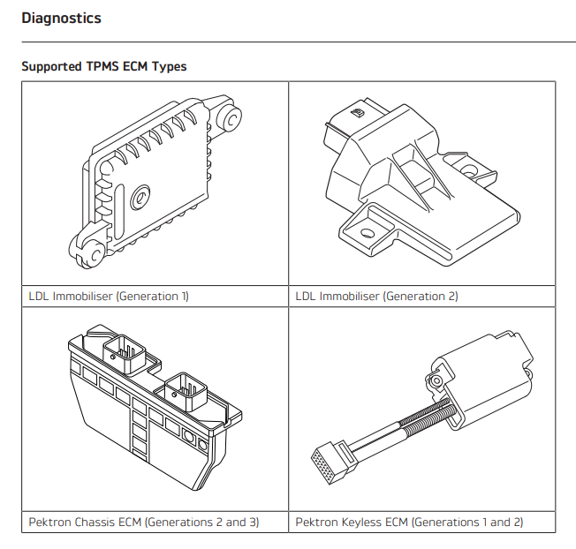
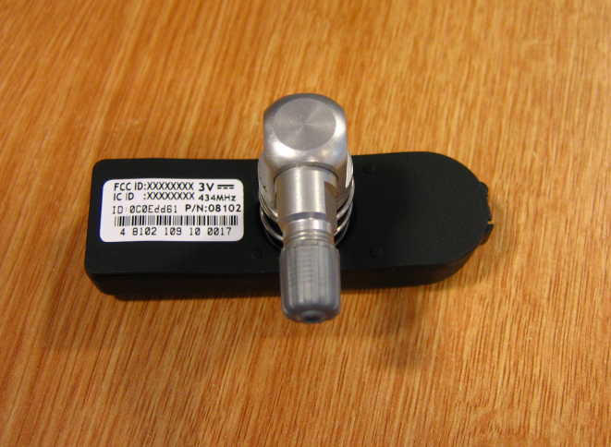
TPMS operation
TLyre Pressure Monitoring System (TPMS) Description
⚠️ WARNING
The tyre pressure monitoring system is not to be used as a tyre pressure gauge when adjusting the tyre pressures. For correct tyre pressures, always check the tyre pressures when the tyres are cold using an accurate tyre pressure gauge.
Use of the TPMS system to set inflation pressures may lead to incorrect tyre pressures, leading to loss of motorcycle control and an accident.
Owners must only adjust tyre pressures when the tyres are cold using an accurate tyre pressure gauge and must not use the tyre pressure display on the instruments.
The tyre pressures shown on the instrument panel indicate the actual tyre pressure at the time of selecting the display. This may differ from the inflation pressure set when the tyres are cold because tyres become warmer during riding, causing the air in the tyre to expand and the pressure to increase. The cold inflation pressures specified by Triumph take account of this.
The TPMS will not transmit the tyre pressure data until the motorcycle is travelling at a speed greater than 12 mph (20 km/h). Two dashes will be visible in the display area until the tyre pressure signal is received.
TPMS Components
Instruments – Used to display the tyre pressure value, the tyre symbol, and the TPMS warning light.
Immobiliser Control Unit – Receives the data from the tyre pressure sensors and sends the information to the instrument pack.
Tyre pressure sensor – Situated inside the front and rear wheel. Each sensor has its own unique ID number and must be recorded in the spaces provided in the Owner’s Handbook. These sensors measure the air pressure inside the tyre and transmit pressure data to the instruments.
The wheel sensor is a sealed unit and must not be opened. The battery inside the sensor is not replaceable and a new sensor must be fitted when the battery voltage becomes too low.
Pressures embedded in the calibration for specific model
Drop of 6psi = light on
315MHZ RF– JP key + tpms
434MHZ RF– ROW key + tpms

Slide 42
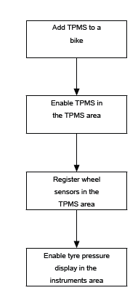
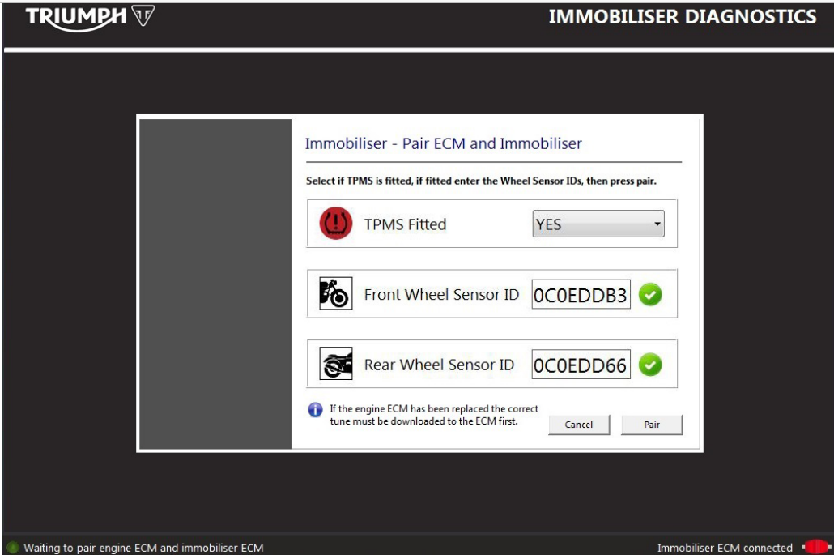
Keyed TPMS Pairing Flow - Keyed

Slide 43
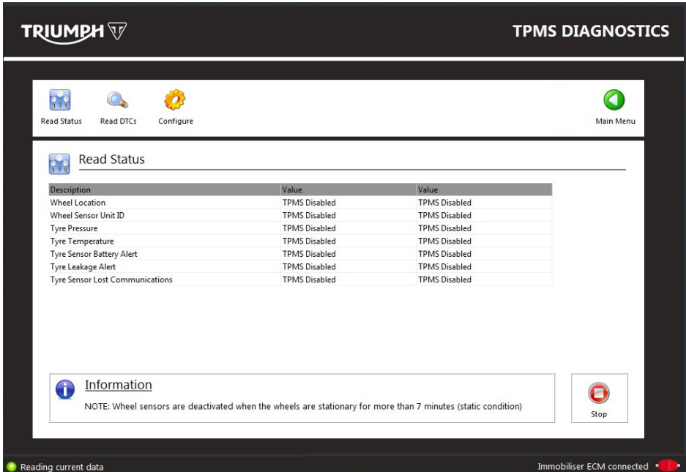
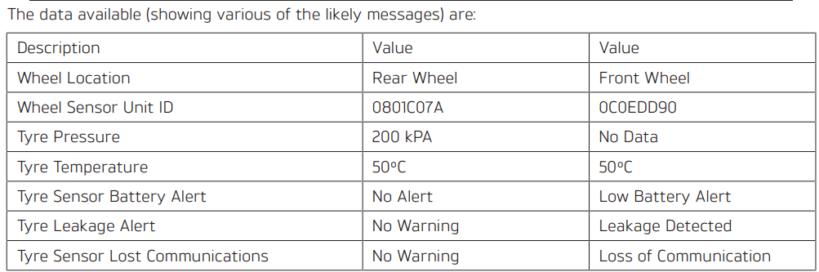
TPMS Data Screen
Note:
The wheel sensors go into a sleep mode seven minutes after the wheels become stationary. If the wheel sensors are in sleep mode, no data will be displayed against tyre pressure and temperature.
To wake the sensors, the bike must be ridden at a speed greater than 18 mph (30 km/h) for at least 30 seconds.

Slide 44
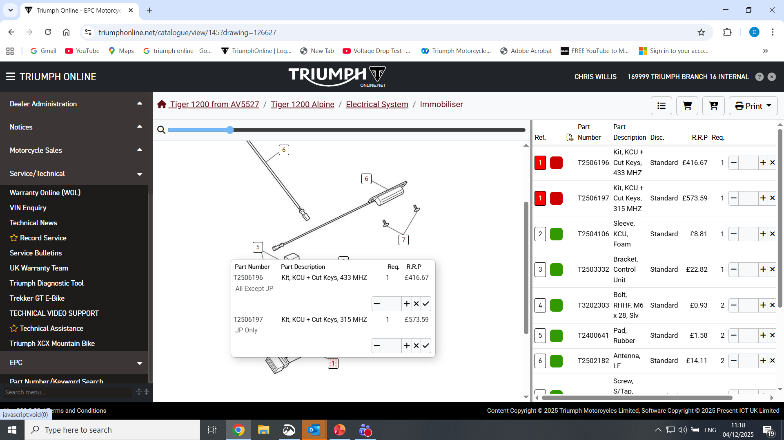
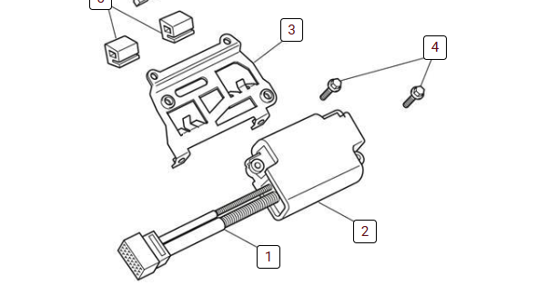
2 x different frequencies and part numbers to suit - Keys
Care must be taken to ensure that the correct frequency is ordered for the correct model. It is recommended to use vin lock EPC

Slide 45
TPMS Questions
Questions with the answers:
Why should tyre pressures always be checked when the tyres are cold?
Because tyres become warmer during riding, causing the air to expand and the pressure to increase.
What might happen if you use the TPMS system to set inflation pressures?
It may lead to incorrect tyre pressures, which can result in loss of motorcycle control and an accident.
At what speed will the TPMS transmit tyre pressure data?
When the motorcycle is travelling at a speed greater than 12 mph (20 km/h).
What is the purpose of the tyre pressure sensor inside the wheels?
Each sensor measures the air pressure inside the tyre and transmits the pressure data to the instruments.
Why must the wheel sensor not be opened or replaced except when the battery is too low?
Because the wheel sensor is a sealed unit; the battery inside is not replaceable, and a new sensor must be fitted when the battery voltage drops.

Slide 46
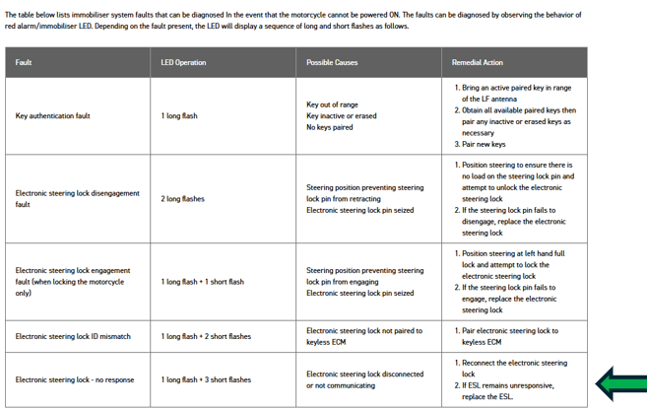
Case Study
Situation:
A customer comes to his bike, the bike will not power on as normal, does not crank or start, nor do the instruments illuminate, the electronic steering lock is fully engaged and will not disengage.
They take the bike to the dealer for diagnostics (on the back of a truck!)
2. The dealer inspects the bike, and should be given a selection of possible options / approaches as steps to resolve the situation.
Replace the bike battery
Replace key fob
Conduct a download
replace the electronic steering lock
replace the keyless control unit
Replace the instrument pack
or other
3. The ‘other’ options should include ‘reading’ the immobiliser flash sequence on the instruments. Include further incorrect answers also such as:
replace key fob battery
replace wiring to kcu
replace the starter switch gear
check switch gear connection etc
If correct answer is chosen as an option, then the flash sequence table should be illuminated.
Inform user at this stage: The flash sequence seen on bike is 1 long flash plus 3 short flashes
The technician should then be given a list of options of what this means various reasons may be given, ie they need to choose the right one from the table.

Slide 47
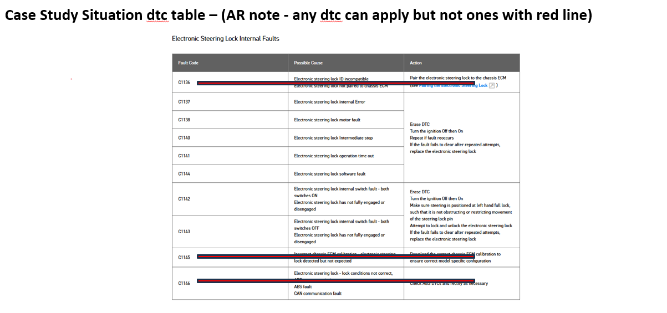
Q - Where can techs find this info? –
TOL
Owners handbook
Internet, it’s a generic code
Ask others
In the manual
From TTI
4. The next option the dealer should be given is how to access further information / dtc about this flash sequence using only the triumph diagnostic tool as the bike doesn’t power on?
The options should include:
This is not possible, as steering lock is inoperative and the instruments won't switch on
This is not possible unless the electronic steering lock is replaced
This is not possible unless the instrument is replaced or swapped
This is possible following a complete download to the KCU
This is possible for just for a 30 second ‘window’, once a connection has been made and established, the connection will continue.
5. Once connection is established, the technician finds the dtc reads C1137 – use the dtc table to determine the cause and remedy
6. Ie The technician should then have to list the correct repair from the table. Reminder to use link from DTC to service manual for access to the fault finding table (if supported by that model).

Slide 48
Bonus Question: one chance at getting right only! But correct answer to be given following the attempt.
Hypothesise on a second related problem
Q - If the same symptom scenario occurred, BUT no TDT access to KCU was possible (ie for the 30 sec window), also no flash sequence on instruments (only the standard immobiliser sequence). What could this mean?
A = Likely KCU not seeing input from switch gear.
Include incorrect answers like:
Instruments may have incorrect software
The LED in the instruments might be inoperative
A theft relay attack may have occurred and the bike has automatically shut down
The TDT software is out of date and requires updating
Once correct answer selected, the answer can be expanded on ie: Possible Inoperative start switch/button or poor connection to start switch/button. Techs should get multi meter to check switch operation, as this would be the only way to check correct operation and circuit connection (ie TDT diagnostics not possible in this instance).

Slide 49
Instrument Panel Flash Sequences

Slide 50
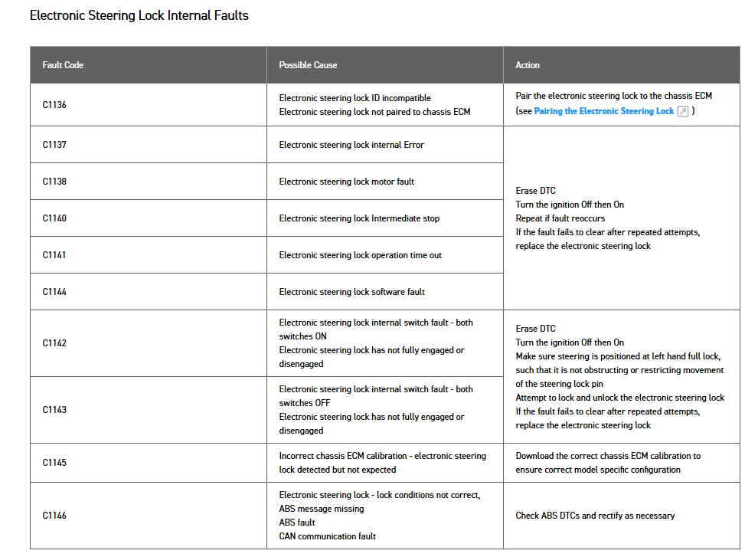
Case Study Situation dtc table – (AR note - any dtc can apply but not ones with red line)
Notes:
Suggest we use the whole table here in some way to show the possibilities, but one of them is shown to be the code/cause/solution that the TDT is showing in this example

Slide 51
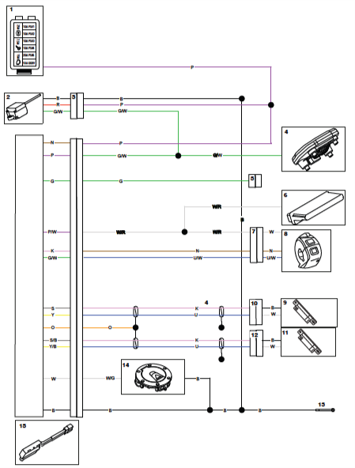
Keyless Ignition and Immobiliser System CASE STUDY - see separate word file
1. Fuse box 1
2. Electronic steering lock
3. Electronic steering lock connector
4. Instruments
5. Engine subharness
6. Chassis ECM
7. Right hand switch housing connector
8. Right hand switch housing
9. LF antenna
10. LF antenna connector
11. LF antenna
12. LF antenna connector
13. Engine ground
14. Fuel filler cap
15. Keyless control unit

Slide 52
Keyless Facts for Diagnostics
The answers to the following questions can be found in the attached PDF document [LINK]
The following questions all have useful to remember answers.

Slide 53
Q1. How often do the smart key and KCU contact each other?
A. Once, during start-up only. ✅
B. Every 30 seconds while the ignition is on.
C. Continuously whenever the key is nearby.
D. Every time the rider touches the handlebars.
Notes:
The old system used to look for the key 10s after pulling away. If it finds it, it will wait 20s before checking again. If it finds it at that time, it will wait 40s…
The duration doubles, up to a limit of 20 mins (1200 seconds).
If the key is ever NOT found, it will keep looking every 10s, if it finds it again the process restarts.
Previously a “missing” key would always be shown for 20 minutes (minimum). Now, the minimum time is 10s.

Slide 54
Q2. If communication fails, how is this indicated?
A. The immobiliser LED flashes the appropriate sequence. A "Key not found" message is not displayed. ✅
B. The TFT immediately displays "Key not found."
C. The engine stops immediately.
D. The horn sounds repeatedly until the key is found.

Slide 55
Q3. How is a "Key not found" message cleared while the engine is running?
A. Once communication is restored, the message no longer appears. ✅
B. Switch the ignition off and back on.
C. Hold the joystick centre button for five seconds.
D. Remove and refit the smart key battery.

Slide 56
Q4. What message is displayed when starting the motorcycle using a passive key (or a smart key operating in passive mode)?
A. No error message is displayed. ✅
B. "Passive key detected."
C. "Key battery low."
D. "Limited key mode."

Slide 57
Q5. A rider starts the motorcycle using a smart key, then switches it into passive mode to conserve the key battery.
What happens?
A. No error message is shown. However, the motorcycle will not restart after the ignition is switched off. ✅
B. The engine stops immediately.
C. A "Key battery low" warning appears.
D. Passive mode is cancelled automatically.

Slide 58
Q6. Which statement about the CR2032 battery used in Triumph keyless fobs is correct?
A. It is a 3 V battery with a 2 V service limit. ✅
B. It is a 1.5 V battery that should be replaced below 1 V.
C. It is a rechargeable 3.7 V lithium battery.
D. Battery voltage is measured with no electrical load applied.

Slide 59
Q7. What DTC is logged if the key battery voltage falls below the 2 V service limit?
A. No DTC is logged. ✅
B. Immobiliser communication fault.
C. Low battery DTC stored in the KCU.
D. CAN communication fault.

Slide 60
Q7. What DTC is logged if the key battery voltage falls below the 2 V service limit?
A. No DTC is logged. ✅
B. Immobiliser communication fault.
C. Low battery DTC stored in the KCU.
D. CAN communication fault.

